Slide 1
16
Financial Leverage and Capital Structure Policy
Prepared by Anne Inglis, Ryerson University
Notes:
13.<number>

Slide 2
Financial management for engineers. Week 10: Summer 2019
Optimal capital structure and financial leverage
16-<number>

Slide 3
Capital Restructuring 16.1
LO1
We are going to look at how changes in capital structure affect the value of the firm, all else being equal
Capital restructuring involves changing the amount of leverage a firm has without changing the firm’s assets, as proposed by Maple group for acquisition of TMX
Increase leverage by issuing debt and repurchasing outstanding shares
Decrease leverage by issuing new shares and retiring outstanding debt, as cos. did after 2008
16-<number>
Notes:
13.<number>

Slide 4
Choosing a Capital Structure
LO1
What is the primary goal of financial managers?
  Maximize stockholder wealth
We want to choose the capital structure that will maximize stockholder wealth
We can maximize stockholder wealth by maximizing firm value or minimizing WACC. This strategy will have an impact on risk
16-<number>
Notes:
13.<number>
Remind students that the WACC is the appropriate discount rate for the risk of the firm’s assets. We can find the value of the firm by discounting the firm’s expected future cash flows at the discount rate – the process is the same as finding the value of anything else. Since value and discount rate move in opposite directions, firm value will be maximized when WACC is minimized.

Slide 5
The Effect of Leverage 16.2
LO1
How does leverage affect the EPS and ROE of a firm?
  When we increase the amount of debt financing, we increase the fixed interest expense
  If we have a really good year, then we pay our fixed cost and we have more left over for our stockholders
  If we have a really bad year, we still have to pay our fixed costs and we have less left over for our stockholders
Leverage amplifies the variation in both EPS and ROE, it is a double edged sword
16-<number>
Notes:
13.<number>
Remind the students that if we increase the amount of debt in a restructuring, we are decreasing the amount of outstanding shares.

Slide 6

Example: Financial Leverage, EPS and ROE
LO1
We will ignore the effect of taxes at this stage
What happens to EPS and ROE when we issue debt and buy back shares of stock?
16-<number>
Notes:
13.<number>
Click on the Excel icon to go to a spreadsheet that contains all of the information for the example presented in the book.

Slide 7
Example: Financial Leverage, EPS and ROE continued
LO1
Variability in ROE
  Current: ROE ranges from 6.25% to 18.75%
  Proposed: ROE ranges from 2.50% to 27.50%
Variability in EPS
  Current: EPS ranges from $1.25 to $3.75
  Proposed: EPS ranges from $0.50 to $5.50
The variability in both ROE and EPS increases when financial leverage is increased
16-<number>
Notes:
13.<number>

Slide 8
Break-Even EBIT
LO1
Find EBIT where EPS is the same under both the current and proposed capital structures
If we expect EBIT to be greater than the break-even point, then leverage is beneficial to our stockholders
If we expect EBIT to be less than the break-even point, then leverage is detrimental to our stockholders
16-<number>
Notes:
13.<number>

Slide 9
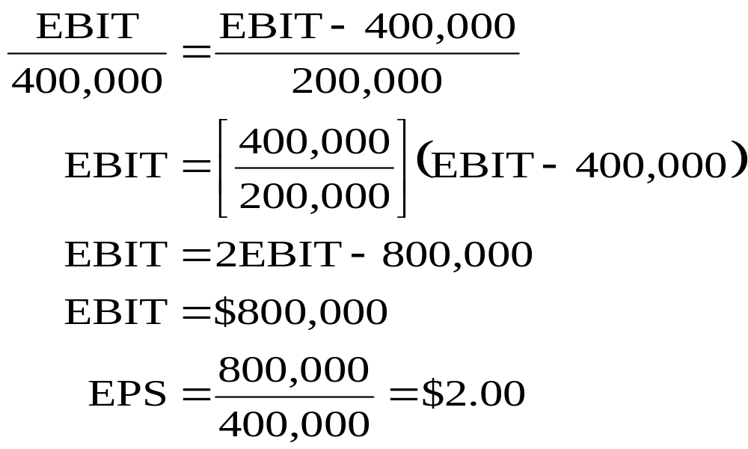

Example: Financial Leverage, EPS and ROE continued
LO1
16-<number>
Notes:
13.<number>
Click on the Excel icon to see the graph of the break-even analysis

Slide 10
Capital Structure Theory 16.3
LO2
Modigliani and Miller Theory of Capital Structure
  Proposition I – firm value
  Proposition II – WACC
The value of the firm is determined by the cash flows to the firm and the risk of the assets
Changing firm value
  Change the risk of the cash flows
  Change the cash flows
16-<number>
Notes:
13.<number>

Slide 11
Capital Structure Theory Under Three Special Cases
LO2
Case I – Assumptions
  No corporate or personal taxes
  No bankruptcy costs
Case II – Assumptions
  Corporate taxes, but no personal taxes
  No bankruptcy costs
Case III – Assumptions
  Corporate taxes, but no personal taxes
  Bankruptcy costs
16-<number>
Notes:
13.<number>

Slide 12
Case I – No Taxes or Bankruptcy Costs
LO2
Proposition I
  The value of the firm is NOT affected by changes in the capital structure
  The cash flows of the firm do not change, therefore value doesn’t change
Proposition II
  The WACC of the firm is NOT affected by capital structure
16-<number>
Notes:
13.<number>
The main point with case I is that it doesn’t matter how we divide our cash flows between our stockholders and bondholders, the cash flow of the firm doesn’t change. Since the cash flows don’t change, and we haven’t changed the risk of existing cash flows, the value of the firm won’t change.

Slide 13
Case I - Equations
LO2
WACC = R_{A} = (E/V)R_{E} + (D/V)R_{D}
R_{E} = R_{A} + (R_{A} – R_{D})(D/E)
  R_{A} is the “cost” of the firm’s business risk, i.e., the required return on the firm’s assets
  (R_{A} – R_{D})(D/E) is the “cost” of the firm’s financial risk, i.e., the additional return required by stockholders to compensate for the risk of leverage
16-<number>
Notes:
13.<number>
Remind students that case I is a world without taxes. That is why the term (1 – T_{C}) is not included in the WACC equation.

Slide 14
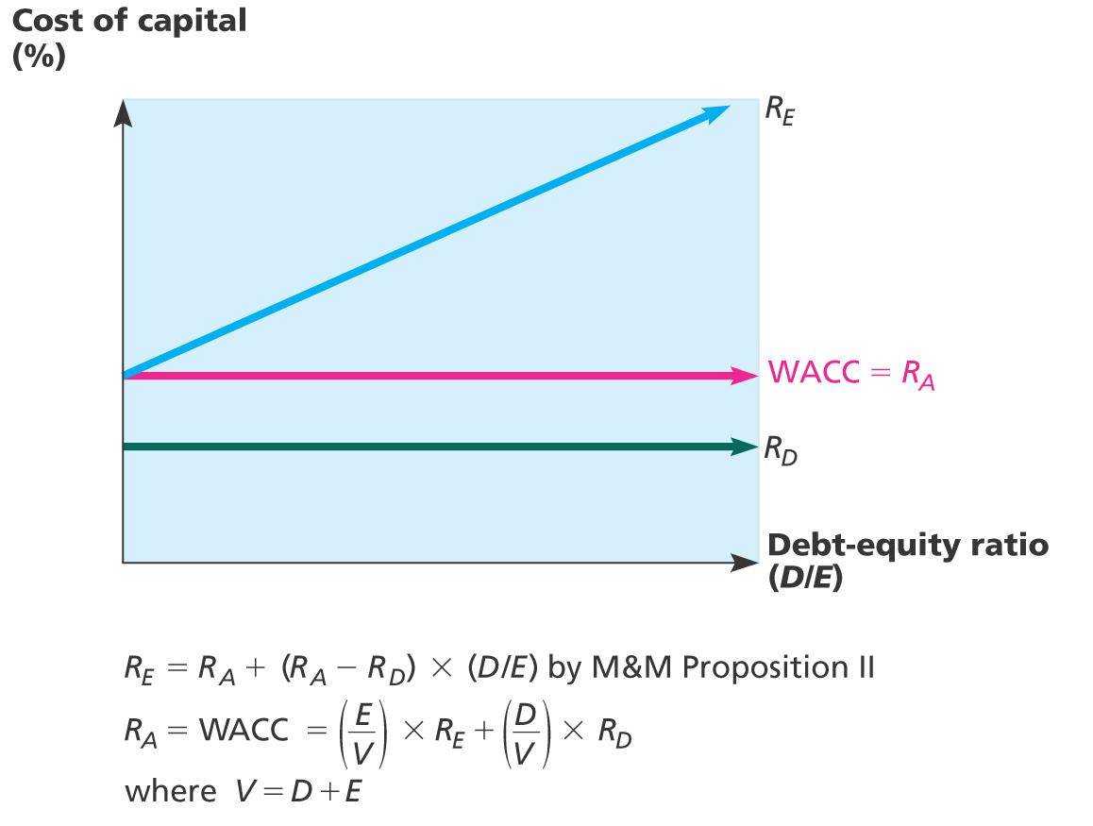
Figure 16.3 – Cost of Equity and WACC (M&M without taxes)
LO2
16-<number>
Notes:
13.<number>

Slide 15
Case I - Example
LO2
Data
  Required return on assets = 16%, cost of debt = 10%; percent of debt = 45%
What is the cost of equity?
  R_{E} = .16 + (.16 - .10)(.45/.55) = .2091 = 20.91%
Suppose instead that the cost of equity is 25%, what is the debt-to-equity ratio?
  .25 = .16 + (.16 - .10)(D/E)
  D/E = (.25 - .16) / (.16 - .10) = 1.5
Based on this information, what is the percent of equity in the firm?
  E/V = 1 / 2.5 = 40%
16-<number>
Notes:
13.<number>
Remind students that if the firm is financed with 45% debt, then it is financed with 55% equity.
At this point, you may need to remind them that one way to compute the D/E ratio is %debt / (1-%debt)
The second question is used to reinforce that R_{A} does not change when the capital structure changes
Many students will not immediately see how to get the % of equity from the D/E ratio. Remind them that D+E = V. We are looking at ratios, so the actual $ amount of D and E is not important. All that matters is the relationship between them. So, let E = 1. Then D/1 = 1.5; Solve for D; D = 1.5. Then V = 1 + 1.5 = 2.5 and the percent equity is 1 / 2.5 = 40%. They often don’t understand that the choice of E = 1 is for simplicity. If they are confused about the process, then show them that it doesn’t matter what you set E equal to, as long as you keep the relationships in tact. So, let E = 5; then D/5 = 1.5 and D = 5(1.5) = 7.5; V = 5 + 7.5 = 12.5 and E/V = 5 / 12.5 = 40%.

Slide 16
The CAPM, the SML and Proposition II
LO2
How does financial leverage affect systematic risk?
CAPM: R_{A} = R_{f} + β_{A}(R_{M} – R_{f})
  Where β_{A} is the firm’s asset beta and measures the systematic risk of the firm’s assets
Proposition II
  Replace R_{A} with the CAPM and assume that the debt is riskless (R_{D} = R_{f})
  R_{E} = R_{f} + β_{A}(1+D/E)(R_{M} – R_{f})
16-<number>
Notes:
13.<number>
Intuitively, an increase in financial leverage should increase systematic risk since changes in interest rates are a systematic risk factor and will have more impact the higher the financial leverage.
The assumption that debt is riskless is for simplicity and to illustrate that even if debt is default risk-free, it still increases the variability of cash flows to the stockholders and thus the systematic risk.

Slide 17
Business Risk and Financial Risk
LO2
R_{E} = R_{f} + β_{A}(1+D/E)(R_{M} – R_{f})
CAPM: R_{E} = R_{f} + β_{E}(R_{M} – R_{f})
  β_{E} = β_{A}(1 + D/E)
Therefore, the systematic risk of the stock depends on:
  Systematic risk of the assets, β_{A}, (Business risk)
  Level of leverage, D/E, (Financial risk)
16-<number>
Notes:
13.<number>
Point out once again that this result assumes that the debt is risk-free. The effect of leverage on financial risk will be even greater if the debt is not default free.

Slide 18
Case II – With Corporate Taxes 16.4
LO2
Interest is tax deductible
Therefore, when a firm adds debt, it reduces taxes, all else equal
The reduction in taxes increases the cash flow of the firm
How should an increase in cash flows affect the value of the firm?
16-<number>
Notes:
13.<number>
Point out that the government effectively pays part of our interest expense for us; it is subsidizing a portion of the interest payment.

Slide 19
Case II – Example 1
LO2
 | Unlevered Firm | Levered Firm
EBIT | 5000 | 5000
Interest | 0 | 500
Taxable Income | 5000 | 4500
Taxes (34%) | 1700 | 1530
Net Income | 3300 | 2970
CFFA | 3300 | 3470
16-<number>
Notes:
13.<number>
The levered firm has 6,250 in 8% debt, so the interest expense = .08(6250) = 500
CFFA = EBIT – taxes (depreciation expense is the same in either case, so it will not affect CFFA on an incremental basis)

Slide 20
Example 1 continued
LO2
Assume the company has $6,250 8% coupon debt and faces a 34% tax rate.
Annual interest tax shield
  Tax rate times interest payment
  6250 in 8% debt = 500 in interest expense
  Annual tax shield = .34(500) = 170
Present value of annual interest tax shield
  Assume perpetual debt for simplicity
  PV = 170 / .08 = 2125
  PV = D(R_{D})(T_{C}) / R_{D} = DT_{C} = 6250(.34) = 2125
16-<number>
Notes:
13.<number>
Point out that the increase in cash flow in the example is exactly equal to the interest tax shield.
The assumption of perpetual debt makes the equations easier to work with, but it is useful to ask the students what would happen if we did not assume perpetual debt.

Slide 21
Case II – Proposition I
LO2
The value of the firm increases by the present value of the annual interest tax shield
  Value of a levered firm = value of an unlevered firm + PV of interest tax shield
  Value of equity = Value of the firm – Value of debt
Assuming perpetual cash flows
  V_{U} = EBIT(1-T) / R_{U}
  V_{L} = V_{U} + DT_{C}
16-<number>
Notes:
13.<number>
R_{U} is the cost of capital for an unlevered firm and equals R_{A} for an unlevered firm.
V_{U} is just the PV of the expected future cash flow from assets for an unlevered firm.

Slide 22
Example 2 – Case II – Proposition I
LO2
Data
  EBIT = $25 million; Tax rate = 35%; Debt = $75 million; Cost of debt = 9%; Unlevered cost of capital = 12%
V_{U} = 25(1-.35) / .12 = $135.42 million
V_{L} = 135.42 + 75(.35) = $161.67 million
E = 161.67 – 75 = $86.67 million
16-<number>
Notes:
13.<number>

Slide 23
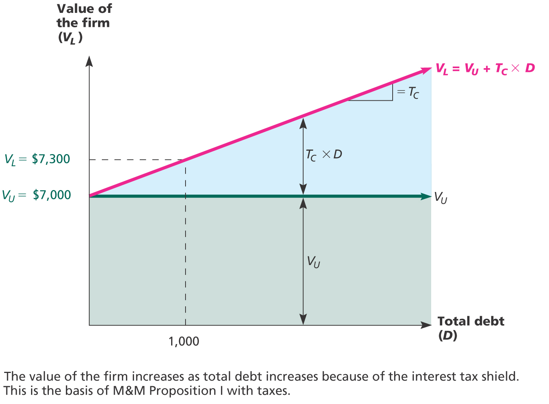
Figure 16.4 – M&M Proposition I with Taxes
LO2
16-<number>
Notes:
13.<number>

Slide 24
Case II – Proposition II
LO2
The WACC decreases as D/E increases because of the government subsidy on interest payments
  WACC = (E/V)R_{E} + (D/V)(R_{D})(1-T_{C})
  R_{E} = R_{U} + (R_{U} – R_{D})(D/E)(1-T_{C})
Example
  R_{E} = .12 + (.12-.09)(75/86.67)(1-.35) = 13.69%
  WACC = (86.67/161.67)(.1369) + (75/161.67)(.09)
  (1-.35)
  WACC = 10.05%
16-<number>
Notes:
13.<number>

Slide 25
Example: Case II – Proposition II
LO2
Suppose that the firm changes its capital structure so that the debt-to-equity ratio becomes 1.
What will happen to the cost of equity under the new capital structure?
  R_{E} = .12 + (.12 - .09)(1)(1-.35) = 13.95%
What will happen to the weighted average cost of capital?
  WACC = .5(.1395) + .5(.09)(1-.35) = 9.9%
16-<number>
Notes:
13.<number>
Remind students that a D/E ratio = 1 implies 50% equity and 50% debt.
In this case, the amount of leverage in the firm increased, the cost of equity increased, but the overall cost of capital decreased.

Slide 26
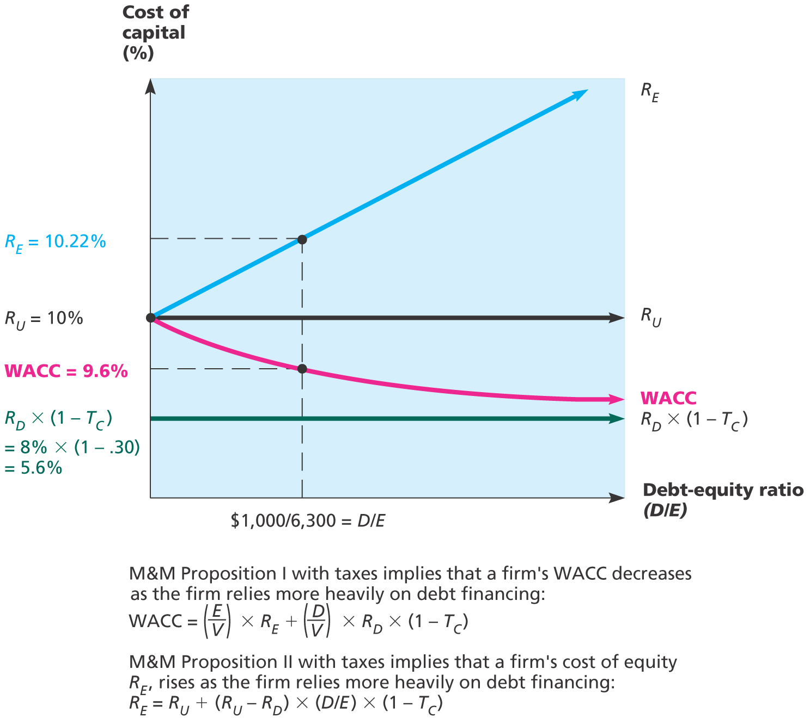
Figure 16.5 – Cost of Equity and WACC (M&M with Taxes)
LO2
16-<number>
Notes:
13.<number>

Slide 27
Case III – With Bankruptcy Costs 16.5
LO2
Now we add bankruptcy costs
As the D/E ratio increases, the probability of bankruptcy increases
This increased probability will increase the expected bankruptcy costs
At some point, the additional value of the interest tax shield will be offset by the expected bankruptcy cost
At this point, the value of the firm will start to decrease and the WACC will start to increase as more debt is added
16-<number>
Notes:
13.<number>

Slide 28
Bankruptcy Costs
LO2
Direct costs
  Legal and administrative costs
  Ultimately cause bondholders to incur additional losses
  Disincentive to debt financing
Financial distress
  Significant problems in meeting debt obligations
  Most firms that experience financial distress do not ultimately file for bankruptcy
16-<number>
Notes:
13.<number>

Slide 29
Static Theory of Capital Structure 16.6
LO2
So what is the optimal capital structure?
A firm borrows up to the point where the tax benefit from an extra dollar in debt is exactly equal to the cost that comes from the increased probability of financial distress
This is the point where the firm’s WACC is minimized
16-<number>
Notes:
13.<number>

Slide 30
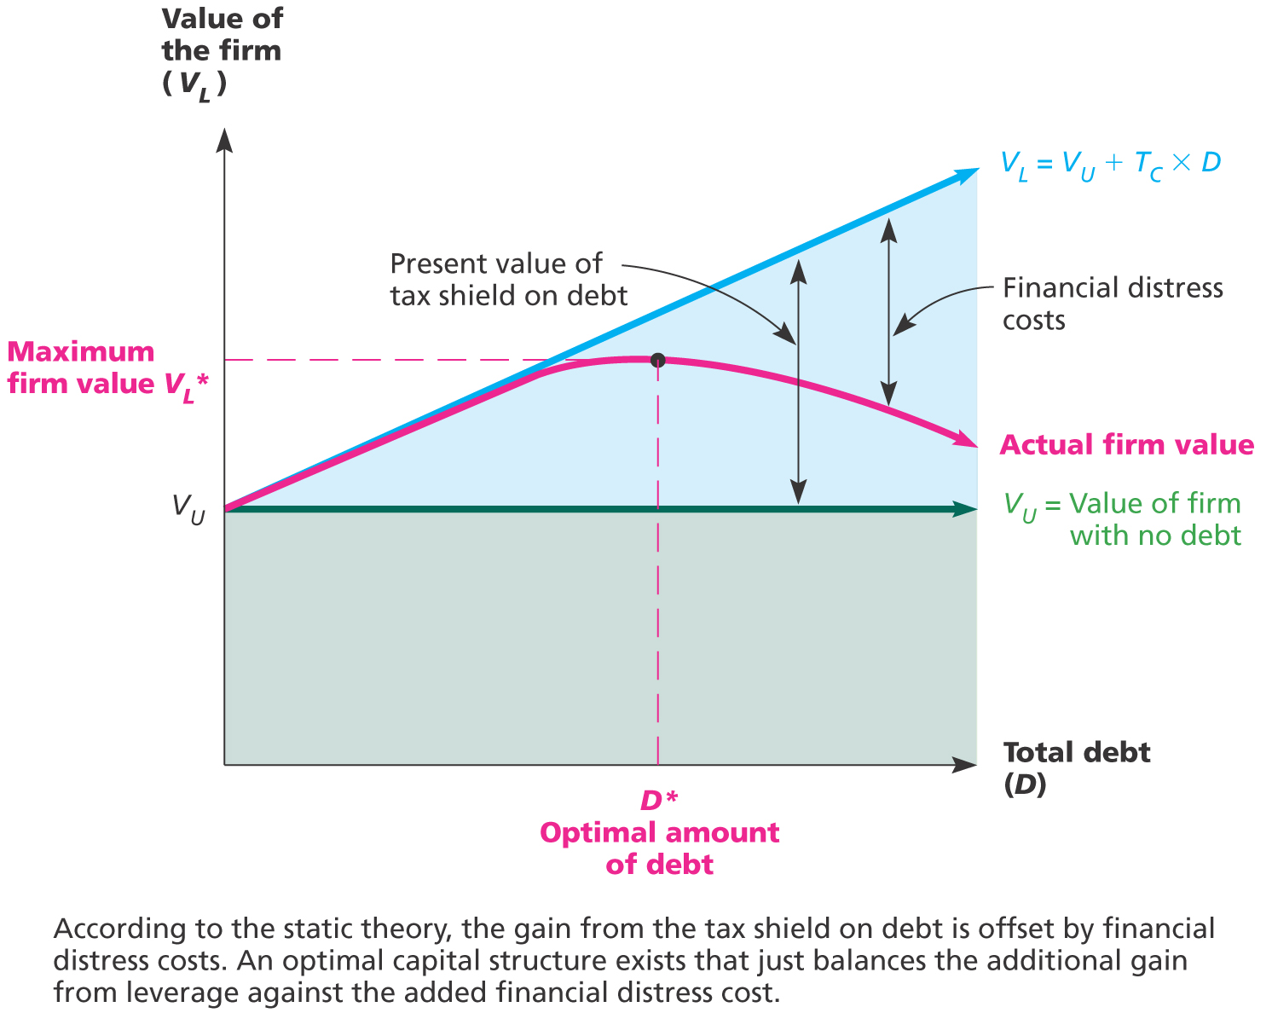
Figure 16.6 – Static Theory and Firm Value
LO2
16-<number>
Notes:
13.<number>

Slide 31
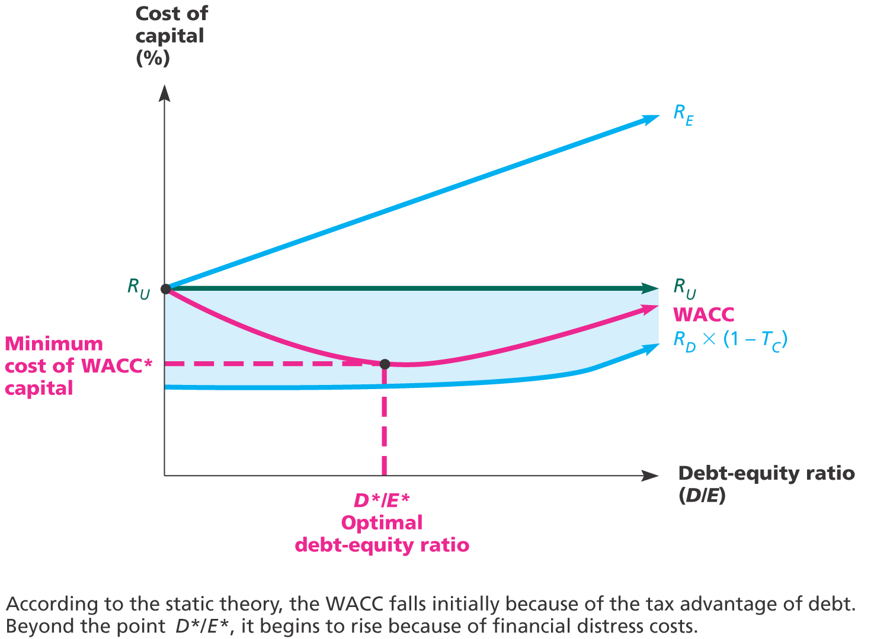
Figure 16.7 – Static Theory and Cost of Capital
LO2
16-<number>
Notes:
13.<number>

Slide 32
Conclusions
LO2
Case I – no taxes or bankruptcy costs
  No optimal capital structure
Case II – corporate taxes but no bankruptcy costs
  Optimal capital structure is 100% debt
  Each additional dollar of debt increases the cash flow of the firm
Case III – corporate taxes and bankruptcy costs
  Optimal capital structure is part debt and part equity
  Occurs where the benefit from an additional dollar of debt is just offset by the increase in expected bankruptcy costs
16-<number>
Notes:
13.<number>

Slide 33
Managerial Recommendations
LO2
The tax benefit is only important if the firm has a large tax liability
Risk of financial distress
  The greater the risk of financial distress, the less debt will be optimal for the firm
  The cost of financial distress varies across firms and industries. As a manager you need to understand the cost for your industry
16-<number>
Notes:
13.<number>

Slide 34
The Value of the Firm
LO2
Value of the firm = marketed claims + non-marketed claims
  Marketed claims are the claims of stockholders and bondholders
  Non-marketed claims are the claims of the government and other potential stakeholders
The overall value of the firm is unaffected by changes in capital structure
The division of value between marketed claims and non-marketed claims may be impacted by capital structure decisions
16-<number>
Notes:
13.<number>

Slide 35
Shortcoming of the Static Theory
LO2
Many large, profitable firms use little debt. Why?
Selling securities is expensive and time consuming
If a firm is very profitable, it might never need external financing
16-<number>
Notes:
13.<number>
This empirical observation is the opposite of what you would expect. You would expect a large, profitable firm to use the most debt because there is little risk of bankruptcy and the value of the tax shield is substantial.
New issues have underwriting fees associated with them. They also can make decisions faster and don’t have to wait for the new issue process to be completed.

Slide 36
Pecking Order Theory
LO2
Firms will use internal financing first.
They will issue debt if necessary.
Equity is sold as a last resort.
Managers are sensitive to the signals that they send with the issue of new securities.
16-<number>
Notes:
13.<number>
Managers are insiders and have asymmetrical information about the firm. If the firm’s future prospects are better than outsiders realize, then they know that the firm’s stock is undervalued and won’t want to issue equity - they will want to issue debt instead. If the stock price is overvalued, then they will want to issue equity because they will want to capitalize on the high price. Companies rarely sell new equity in the real world because investors read the signals that the managers send and the market reacts negatively to new equity sales.

Slide 37
Implications of the Pecking Order
LO2
Firms don’t have a target capital structure
Profitable firms use less debt – they have greater internal cash flow and need less external financing
Companies want financial slack and stockpile internally generated cash as a result
16-<number>

Slide 38
Observed Capital Structures 16.8
LO2
Capital structure does differ by industry
Seems to be a connection between different industry’s operating characteristics and capital structure
Firms and lenders look at the industry’s debt/equity ratio as a guide
16-<number>
Notes:
13.<number>
See Table 16.7 in the book for more details.

Slide 39
References
H De Angelo and R Masulis “ Optimal capital structure under corporate and personal taxation . Journal of Financial Economics ( March 1980)
S C Myers “ The capital structure puzzle”. Journal of finance 39 July 1984
16-<number>

